Slide 1

Basic data statistics and Exploratory Data Analysis (EDA)
Priyanka Dilip Shinde
Email: shinde.pr@northeastern.edu

Slide 2

Introduction
In today's world, data is everywhere, and it's becoming increasingly important to be able to analyze and make sense of it. That's where basic data statistics and EDA come in.
These are essential tools for anyone working with data, whether you're a scientist, a business analyst, or just someone who wants to understand the world around them better.

Slide 3
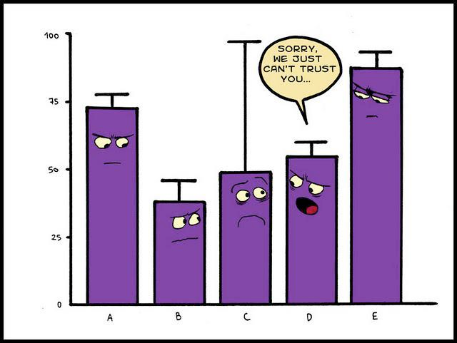
What are Basic Data Statistics?
Basic data statistics are fundamental measures used to describe and summarize data. They help us understand the characteristics of a dataset, such as its central tendency, variability, and shape.
For example, if we were analyzing sales data for a company, we could use the mean to determine the average amount of sales per month, the variance to measure the spread of the data, and the standard deviation to see how much the data deviates from the mean. These statistics provide valuable information that can inform business decisions and help drive success.

Slide 4
Descriptive statistics
Descriptive statistics provide a summary of key characteristics within a dataset. They help us gain insights into the overall structure and patterns of the data.
Measures of Central Tendency:
Mean: The average value of the data.
Median: The middle value in the sorted dataset.
Mode: The most frequently occurring value.
Measures of Dispersion:
Range: The difference between the maximum and minimum values.
Variance: The average of the squared differences from the mean.
Standard Deviation: The square root of the variance.
Percentiles and Quartiles:
Percentiles divide data into percent intervals (e.g., the 25th, 50th, and 75th percentiles).
Quartiles divide data into four equal parts.

Slide 5

What is Exploratory Data Analysis (EDA)?
Exploratory Data Analysis (EDA) is a process of analyzing data sets to summarize their main characteristics, often with visual methods. It helps to identify patterns, relationships, and anomalies in the data that may not be immediately apparent.
EDA is an important step in data analysis as it allows us to gain insights into the data and form hypotheses about the underlying relationships between variables.
One of the key benefits of EDA is that it can help us to identify outliers or extreme values in the data. These outliers can have a significant impact on the results of statistical analyses, so it's important to identify and address them early in the analysis process.
Additionally, EDA can help us to identify missing data or errors in the data set, which can also impact the accuracy of our analyses.

Slide 6
Types of Exploratory Data Analysis (EDA)
1. Univariate Analysis:
Focuses on a single variable at a time.
Involves calculating descriptive statistics, visualizing distributions, and identifying outliers.
Helps understand the characteristics of individual variables.
2. Bivariate Analysis:
Examines relationships between two variables.
Involves scatter plots, correlation analysis, and cross-tabulations.
Aims to discover associations and dependencies between variables.
3. Multivariate Analysis:
Studies relationships between multiple variables.
Utilizes techniques like pair plots, heatmaps, and principal component analysis (PCA).
Reveals complex interactions and patterns within data.
Common plots: Histogram, Box plot, Bar plot
Common plots: Scatter plot, Bar plot

Slide 7
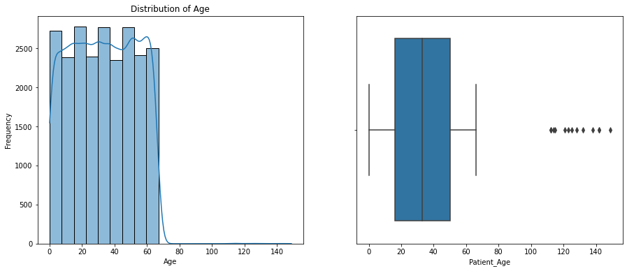
Univariate Analysis
Distribution of Patient age is uniform and box plot shows that there are outliers present in patient age feature

Slide 8
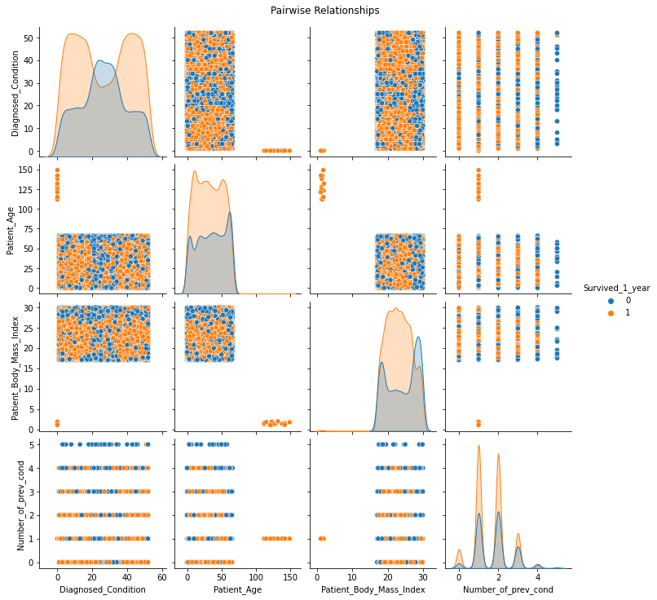
Bivariate Analysis Pairplot shows scatter plots of pairwise relationships between selected numerical variables in the dataset, with the diagonal subplots showing smoothed distributions (using kernel density estimates) of each variable. Different categories in the 'Survived_1_year' column are color-coded.

Slide 9
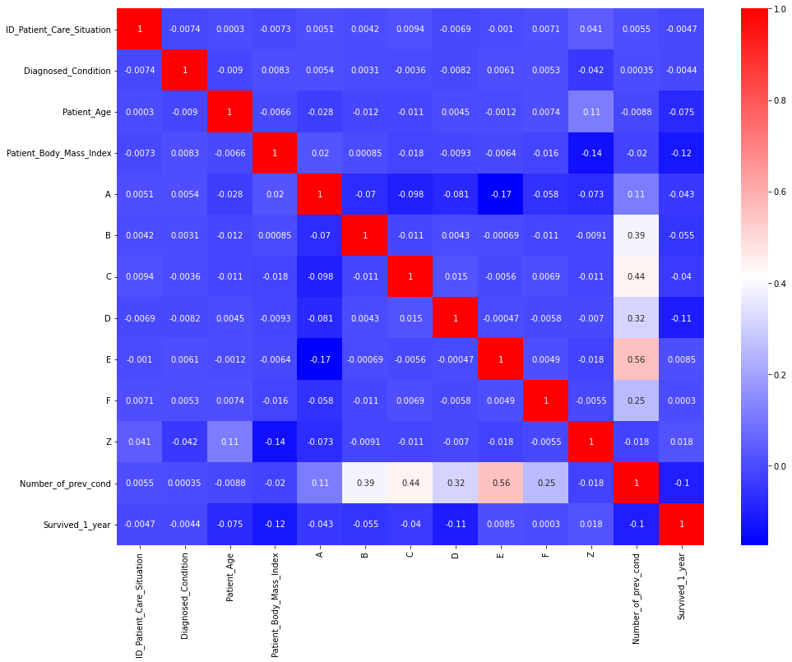
Multivariate Analysis Values close to 1 are positively correlated, values close to -1 are negatively correlated and values close to 0 does not have linear relationship with each other.

Slide 10
Steps in Exploratory Data Analysis
Loading Libraries
Loading Data
Analyzing Data
Descriptive Statistics
Dropping Irrelevant Features
Taking care of the missing data
Data Wrangling
EDA (Exploratory Data Analysis) Univariate Analysis, Bivariate Analysis, Multivariate Analysis
Finding Important Features (using p-value)
Feature Engineering (Categorical encoding)

Slide 11
Quiz
What does multivariate analysis involve?
Analyzing a single variable at a time.
Studying the relationships between multiple variables.
Focusing only on numerical variables.
2. Name three measures of central tendency.
Mean, medium, mode
Average, range, variance
Mean, median, mode
3. What is the range of correlation coefficient values?
-1 to 1
0 to 1
-∞ to ∞

Slide 12
Thank You!

